Slide 1
Suggested Arduino Development
Eric Sandoz
11/5/2014

Slide 2
Human Machine Interface
Main Hydraulic Pressure Control
Joystick HMI
- X,Y: 0-5V Analog
- 4 Buttons 0-5V Digital
Arduino Microcontroller
Contactor FET
(0-12V on/off)
Pump Contactor
(0-12V on/off)
Hydraulic Pump
(12V)
Pump Hydraulic Pressure Sensor
(0-5V analog)
Auxiliary Switches
- 4 Buttons 0-5V Digital
Brake Pressure Control
Traction Motor Control
Valve Coil FET
(0-12V PWM)
Hydraulic Valve
(0-12V on/off)
Brake Cylinder
Contactor FET
(0-12V on/off)
Valve Coil FET
(0-12V PWM)
Motor Contactor
(0-12V on/off)
DAC
(0-5V)
Brake Hydraulic Pressure Sensor
(0-5V analog)
Traction Motor Controller (72V)
OpAmp
(0-5V Analog)
Steer Angle Control
Traction Motor (72V)
Valve Coil FET
(0-12V PWM)
Hydraulic Valve
(0-12V on/off)
Steer Rotary Actuator
Rear Wheel Speed Sensor
(0-5V PWM)
Valve Coil FET
(0-12V PWM)
Steer Angle Sensor
(0-5V PWM)
Description | Type | Qty
Input: Analog Voltage (0-5V) | Analog | 4
Input: PWM Input (0-5V) | PWM | 3
Input: Digital Switch | On/Off | 9
Output: FET Drive | On/Off | 2
Output: FET Current Drive | PWM | 6
Output: Analog Voltage (0-5V) | DAC | 1
Lean Angle Control
Valve Coil FET
(0-12V PWM)
Hydraulic Valve
(0-12V on/off)
Lean Rotary Actuator
Valve Coil FET
(0-12V PWM)
Lean Angle Sensor
(0-5V PWM)

Slide 3
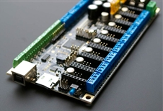
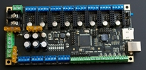
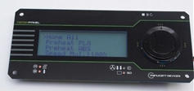
Suggested Arduino Hardware
Panucatt Azteeg X3 Pro (3D Printer Controller)
Arduino Mega based (12 V, high current capable)
Screw terminals makes wiring easy
FETs for driving coils etc. already included
Supports enough I/O for Dagne as is
6 Analog Inputs
2 Thermocouple Inputs
8 PWM 12 V 20A outputs
6 Digital Inputs
1 high current FET (100A)
SD Memory interface
LCD Interface
USB
Breakout headers for more I/O
http://www.panucatt.com/ProductDetails.asp?ProductCode=AX3pro
Can drive ViKi LCD for more HMI with Arduino libraries
http://www.panucatt.com/product_p/vikilcd.htm
This will be the quickest way to get going, focusing on wiring and software and not circuits and soldering

